Slide 1

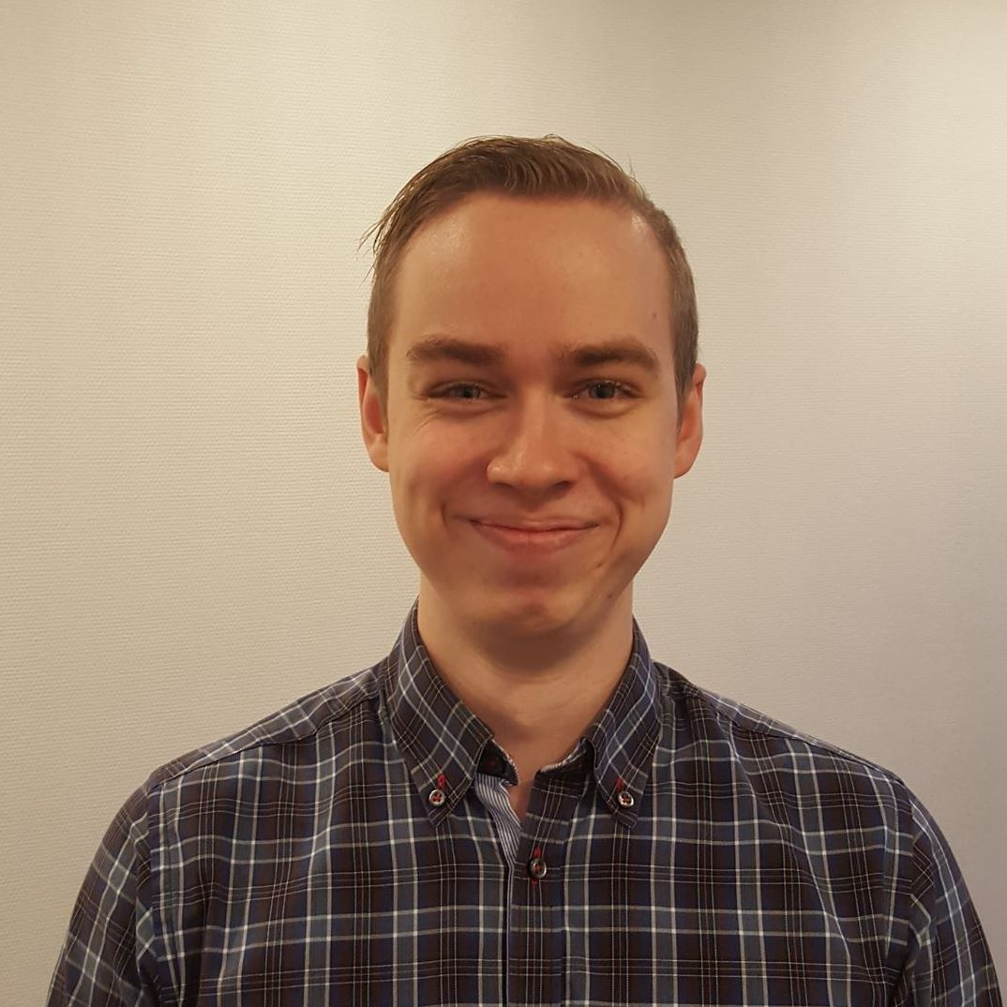

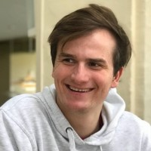
The
Archi
tects
Notes:
Ramuld

Slide 2
Agenda
Pitch
QAW Highlights
Synthesis
Prototyping
Q&A
Notes:
Ramuld

Slide 3
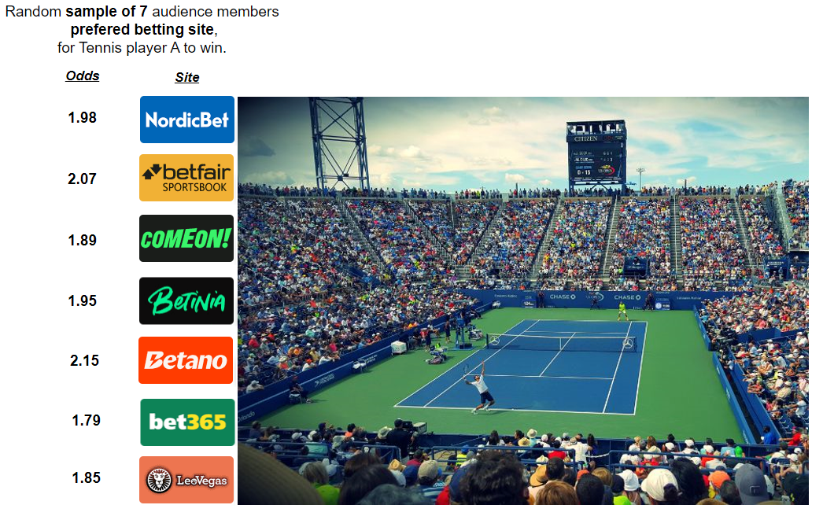
Pitch
Who has the best odds? - and why isn’t it always me?
Notes:
Jacob

Slide 4
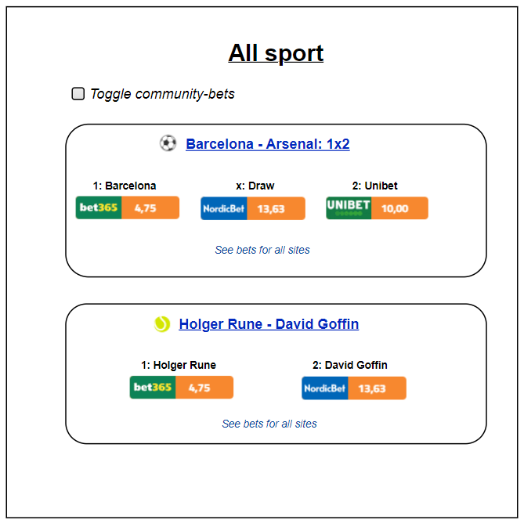
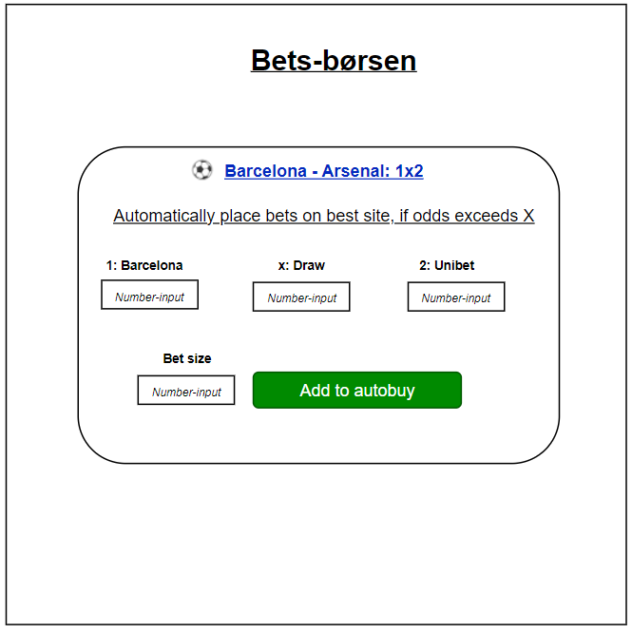
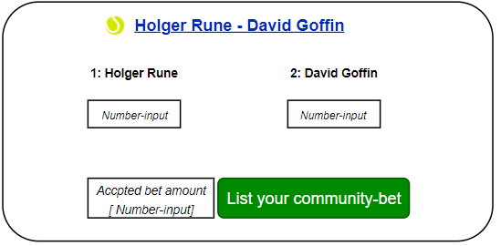
Pitch
Core idea - Always shown best bets, from any bookmaker
Trigger-orders
Stock-like features
Be your own broker
Notes:
Jacob

Slide 5
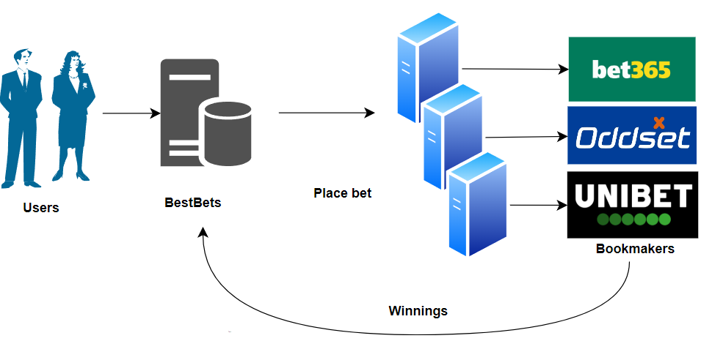
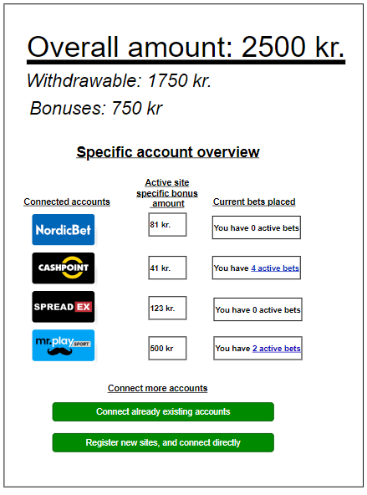
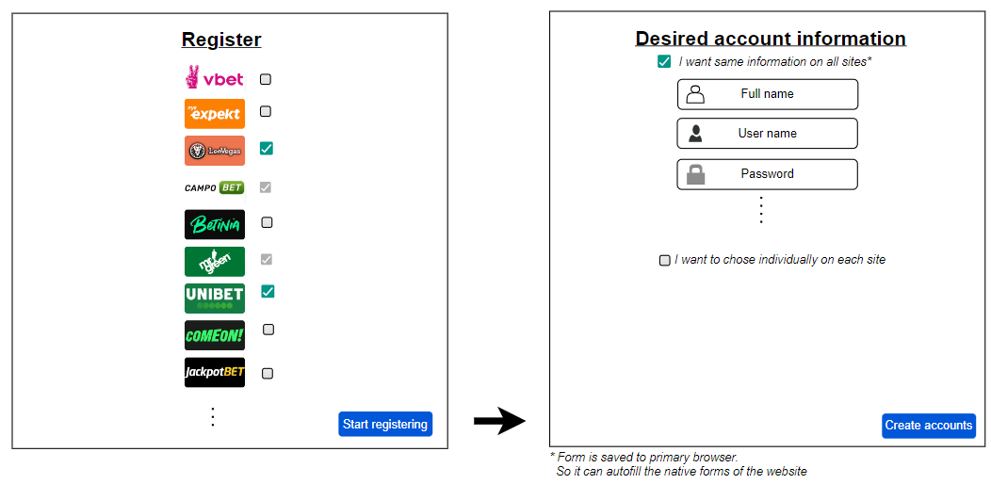
Pitch
Centralized “banking”
Overview
Quickly register
Notes:
Jacob
Image wanting right now to be fully ready to place 200 kr. On any betting site.
It would require 9600 kr in down-payment. And imagine the cognitive overload, of quickly navigating 48 different bookmakers UI.

Slide 6
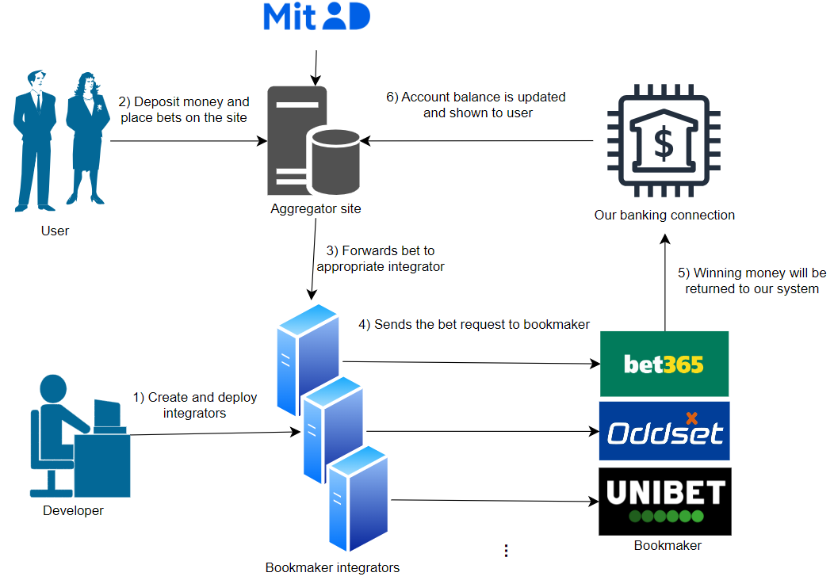
Pitch summary
Always get shown the best bets
Only cash on a single site
Consistent behaviour for every bookmaker
Notes:
Jacob

Slide 7
QAW Highlights
Quality
Performance
Modifiability
Safety
World cup
Many external bookmakers
update their odds
Many BestBets logins
Many bets to forward
Bookmaker
Remove
Add
Changing API
Bets
Odds change before confirmation
Different thresholds
Impossible: removed from bookmaker
Scenarios
Votes
14
11
10
Notes:
Thor

Slide 8
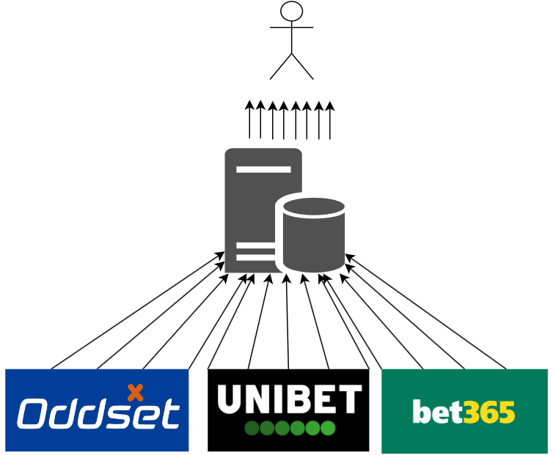
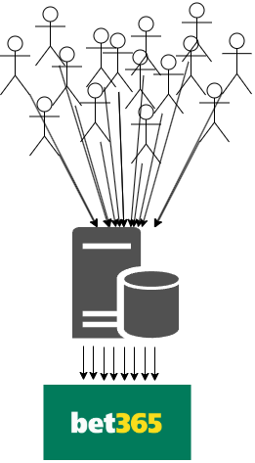
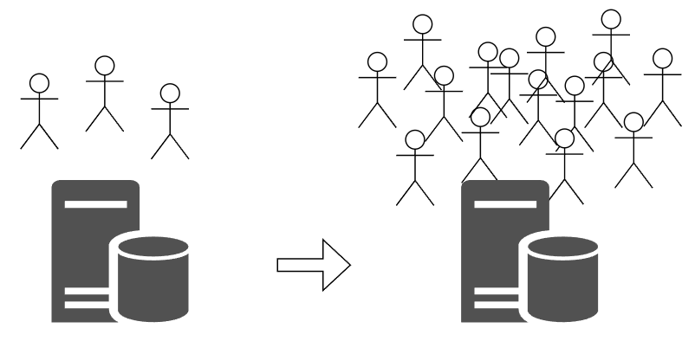
Performance scenarios & styles & tactics
Scenarios
Real-Time Betting Odds Update
User login surge
Surge of bets
Pattern considered:
Event broker
Message queuing with the Actor model
Tactics considered:
In general, Introduce concurrency: Make the work embarrassingly parallelizable
Control resource demand: Prioritize whales*
"86% of online gambling profits comes from 5% of the players.“ - Les Bernal ["Raising the stakes" (2024), CBC NEWS]
Notes:
Thor

Slide 9
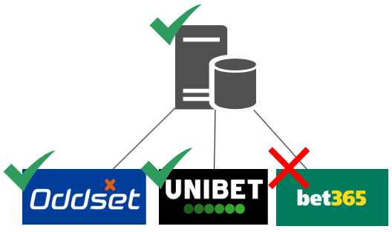

Modifiability Scenarios & styles & tactics
Scenarios
Addition and removal of bookmakers ^{[1]}
Adapt to changing bookmaker API’s
BettingId → MatchId
Pattern considered:
Microkernel
Tactics considered:
Let each actor handle
only one bookmaker
Split module & encapsulate external calls: Increases cohesion, reduces coupling.
[1] - 12 new bookmakers since 2019 [Spillemyndighederne: https://www.spillemyndigheden.dk/tilladelsesindehavere?field_license_type_target_id=All
Notes:
Jacob

Slide 10
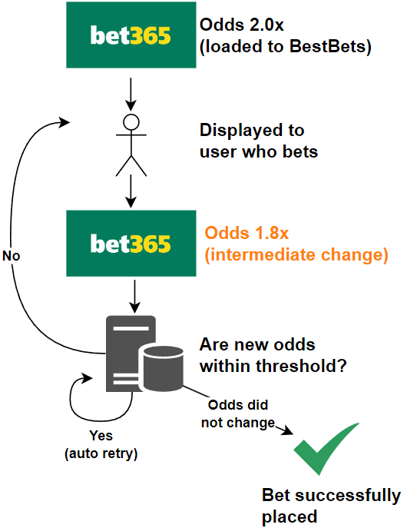
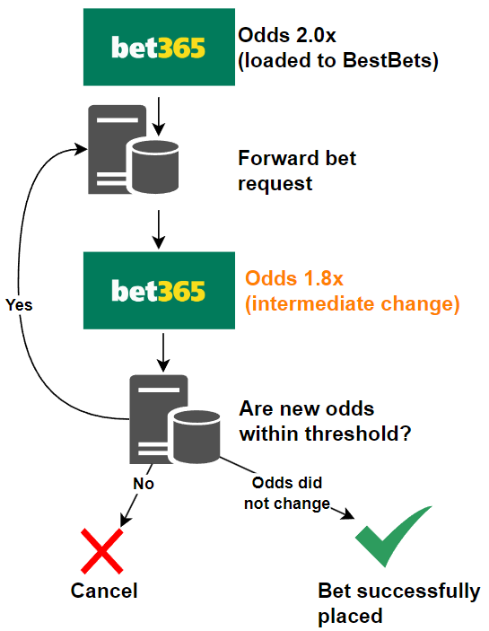
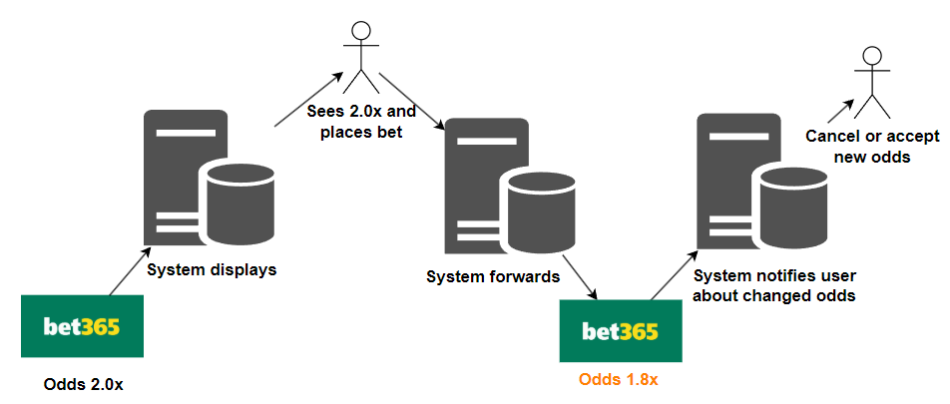
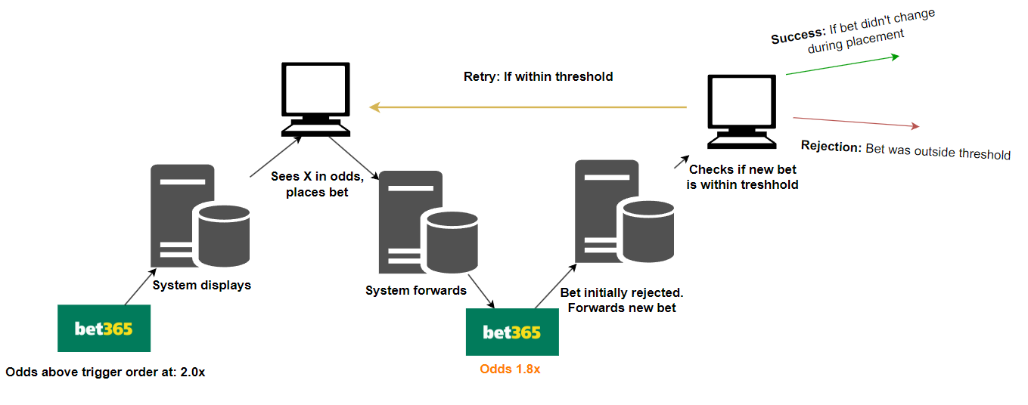
Safety Scenarios & styles & tactics
Without threshold / Non-trigger order
With threshold / trigger order
Scenarios
Pattern considered:
Actor model with message passing.
A single actor handles a complete transaction before being killed
Transactions:
Consider initial bet placement as start of transaction,
And final confirmation/rejection as end of transaction.
Tactics considered:
Notes:
Ramuld

Slide 11
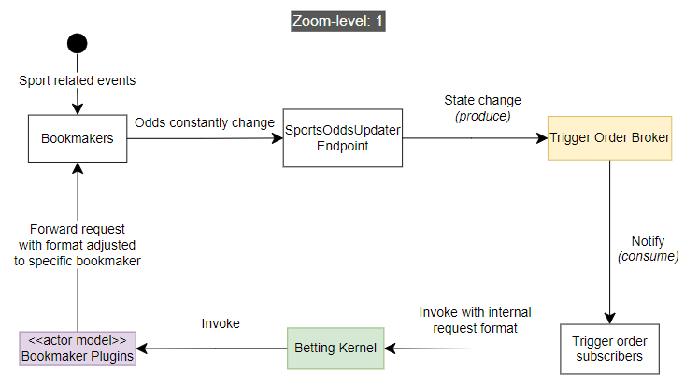
Trigger order & Bet placement Zooming in on the prototype
Notes:
Jacob

Slide 12
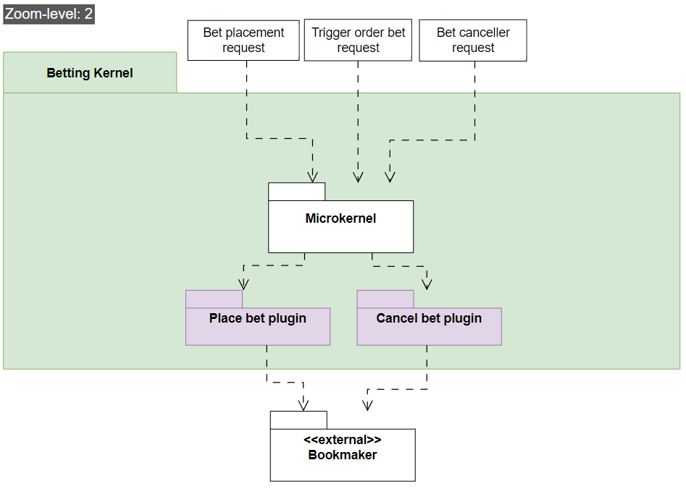
Microkernel zoomed in view
Notes:
Thor

Slide 13
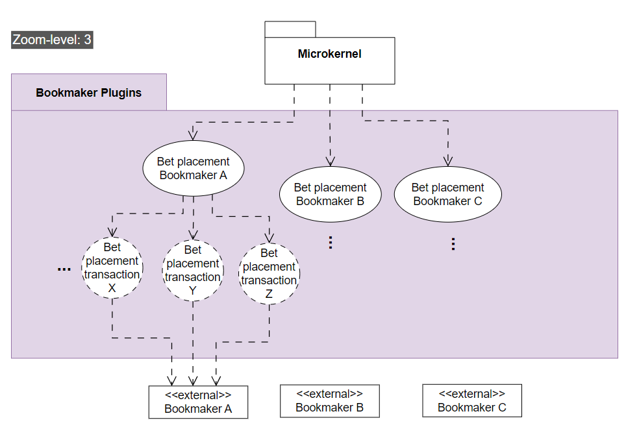
Plugin actor model zoomed in view
Notes:
Thor

Slide 14
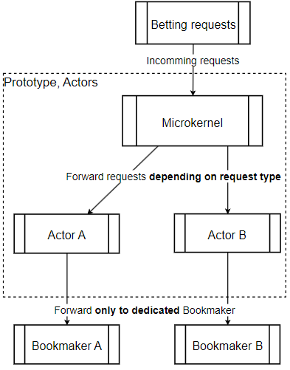
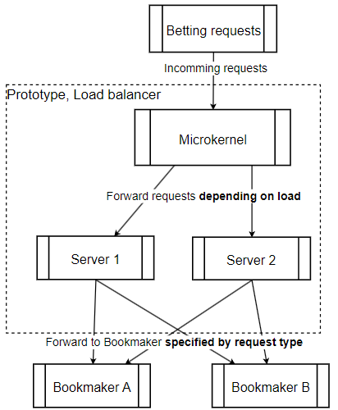
Prototyping
Concerns
Can the system handle
world-cup-sized events?
Can a bet transaction complete fast
enough to get successfully placed?
Hypothesis
Performance
The load balancer will perform
Better than the actor model
Safety
The actor model will complete
a single transaction with fewer
retries than the load balancer.
Actions to take during AP
Measure response time statistics
Measure average retries
Actor model
VS
Load balancer
Notes:
Ramuld

Slide 15
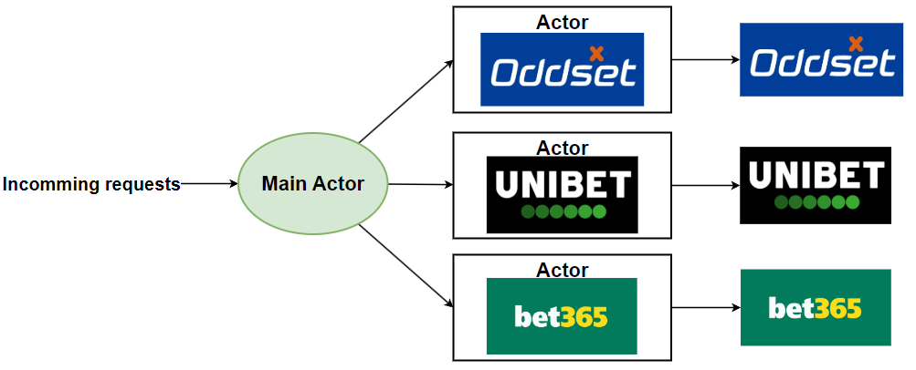
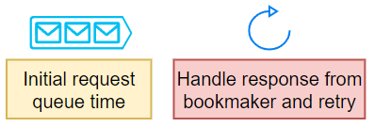
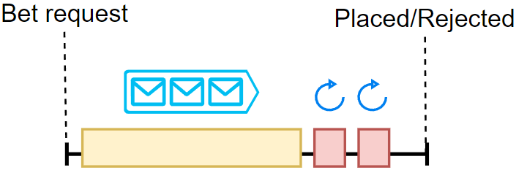
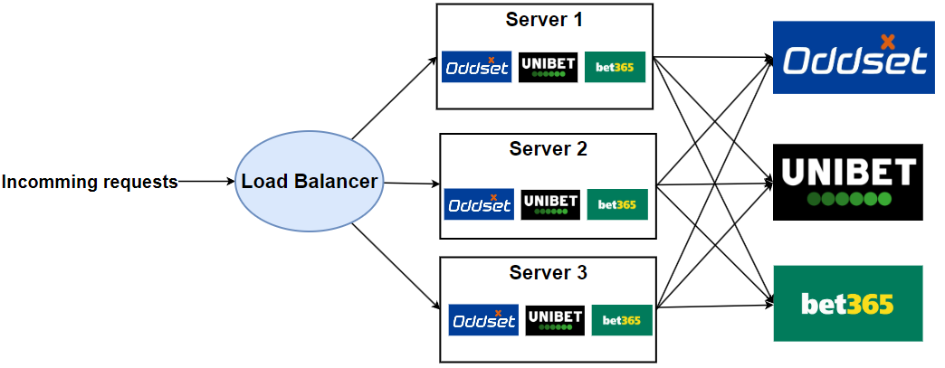
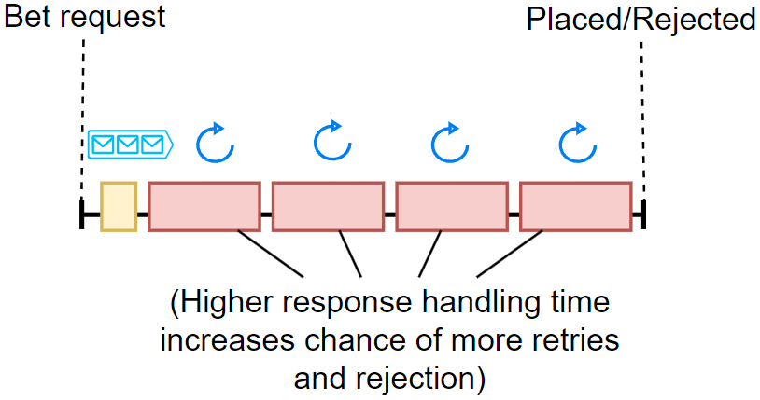
Actor model
Load balancer

Slide 16
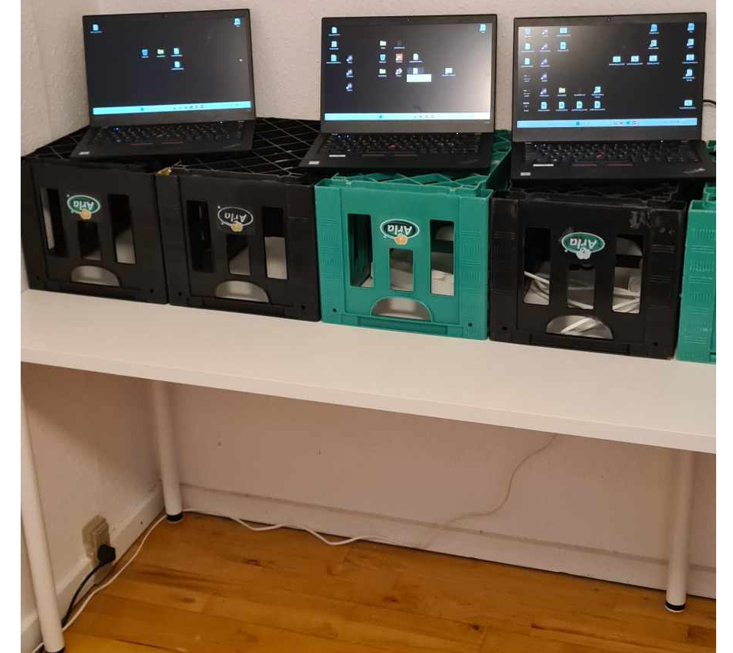
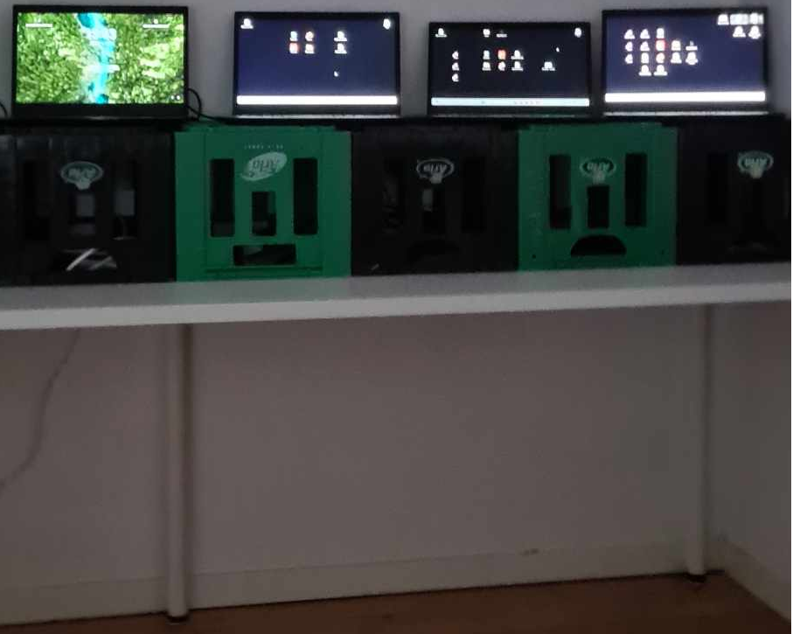
Test setup
* All are Lenovo Thinkpads T490 * All are on different networks Courtesy of Grumlebet
Microkernel Load balancer / Actor forwarder
Multiple clients
Multiple servers / actors
Notes:
Jacob

Slide 17
Threats to validity
Prototype doesn’t correctly simulate retries
Every “bookmaker” had same logic. In real life bookmaker behaviour will vary greatly.
Local vs real network
Notes:
Jacob

Slide 18


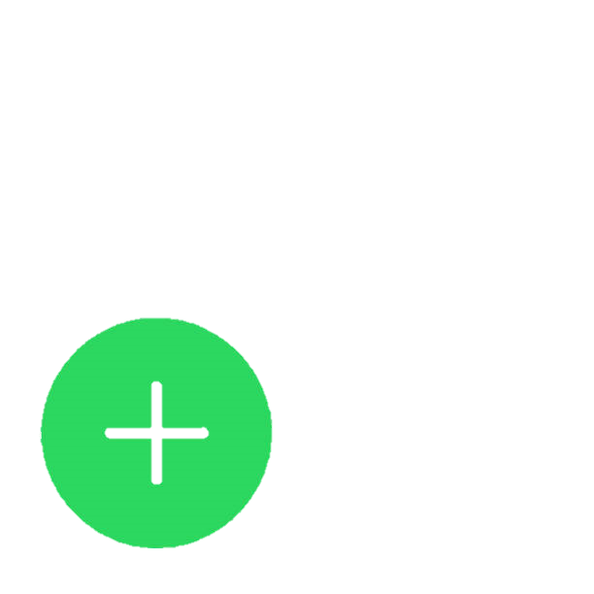
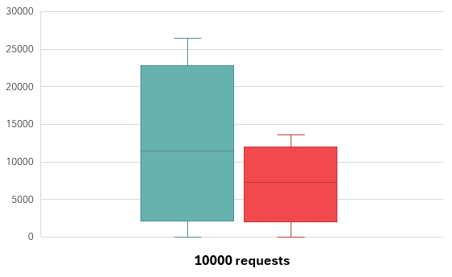
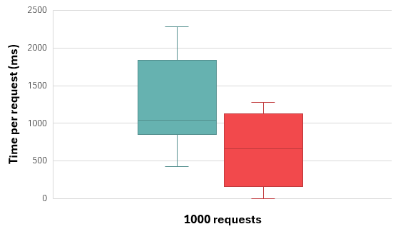
Results
Actor model |  | Load balancer
Lower throughput | Performance | Higher throughput
Guaranteed single transaction prioritization | Safety | Complex prioritization
Notes:
Ramuld

Slide 19
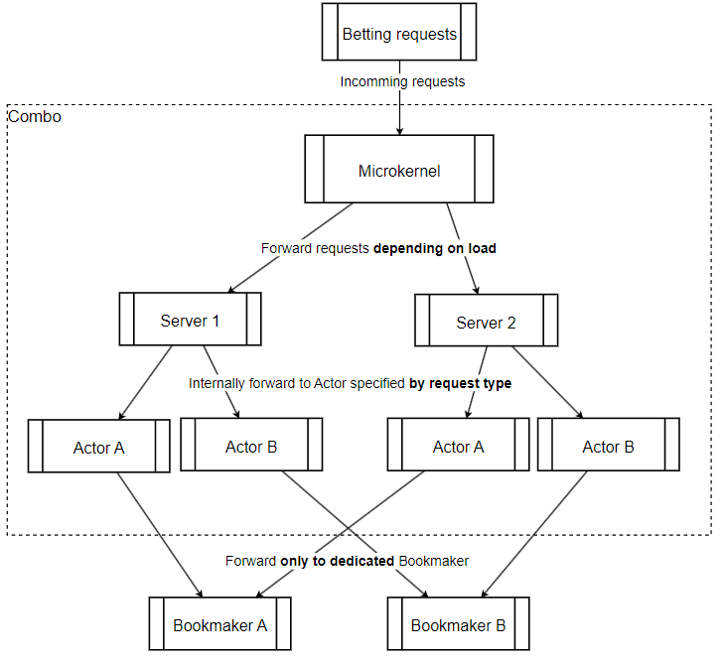
Conclusion
Perhaps a combo?
Pros:
Load balancing to prevent bottlenecks
Actors give natural separation and simple prioritization
Cons:
Adds another step to the process which increases latency.
Slight increase to modifiability complexity
Notes:
Thor

Slide 20
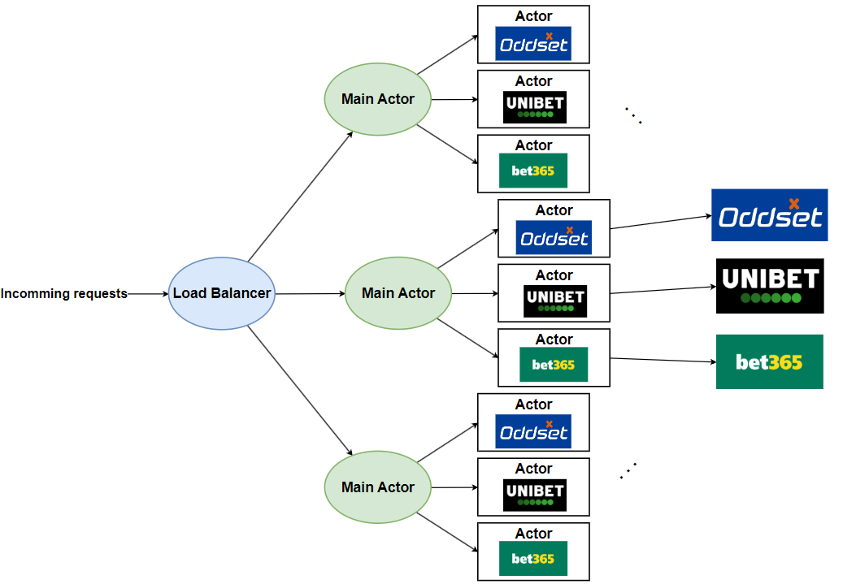
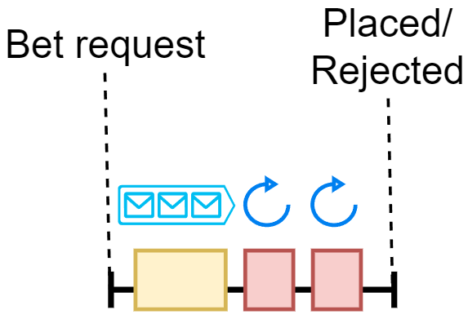
Load balanced Actor Model

Slide 21
Relevant pieces from the log
We want to zoom in on the event broker as well and make a prototype
We want to look more in-depth into the combo-solution
Notes:
Ramuld

Slide 22
Thank you
Questions?

